Slide 1




AI-POWERED
FACE SEARCH SYSTEM
AI-Powered Face Search System

Slide 2







Guest Photo Discovery & Purchase Flow
01
02
03
04
05
Scan selfie
System detects faces
Matched photos with watermark previews appear
Makes secure payment
Download or Email

Slide 3




How Face search AI works
Convert to Embeddings
Scan & get all matched images
Upload all captured images
Store all face embeddings to DB

Slide 4
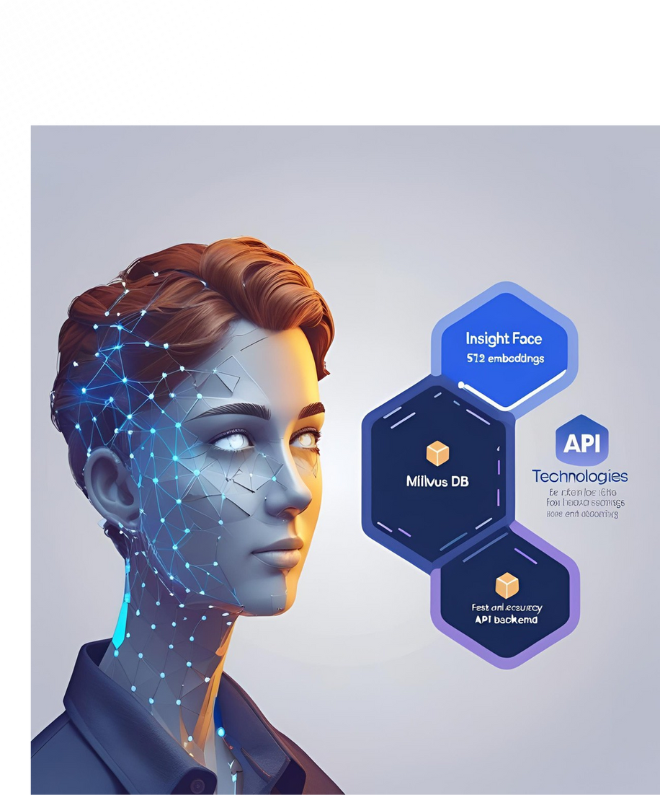





The Technology Powering Our Solution
Insight Face – AI Face Engine
Milvus DB – High-Speed Vector Search
Fast API – Scalable Backend
Docker – Easy Scaling & Deployment

Slide 5

Face Search AI-Architecture
pymilvus, Vector search, Meta data storage, similarity indexing
Open cv2, Insight Face
User input
Face embeddings Generation
Download & Share
Milvus
vector db
Backend
Fast API, Uvicorn, pydantic, numpy

Slide 6

Thank You

